Slide 1
Experiment Scenario
flow 2
r₂ = B
1
rx
tx
r₁ = B
flow 1
3
2
tx
rx
flow 3
rx
tx
r₃ = B
In addition to flow 1, flow 2 and flow 3, we generate K extra flows to each link (i.e. K flows that go from switch 1 to switch 2, K flows from switch 2 to switch 3, K flows from switch 3 to switch 1.

Slide 2
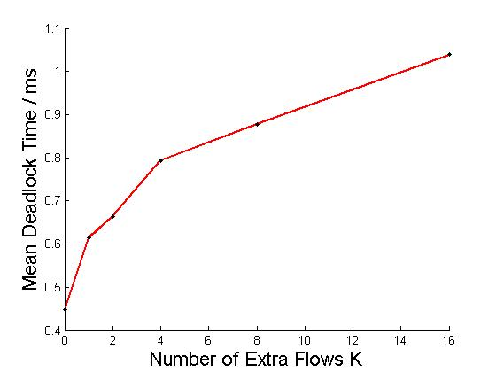
Simulation results – Exp1
Setting:
Each extra flow has 40Gbps injection rate.
Vary K from 0 to 29.
as K goes up, the time to form deadlock will also go up.

Slide 3
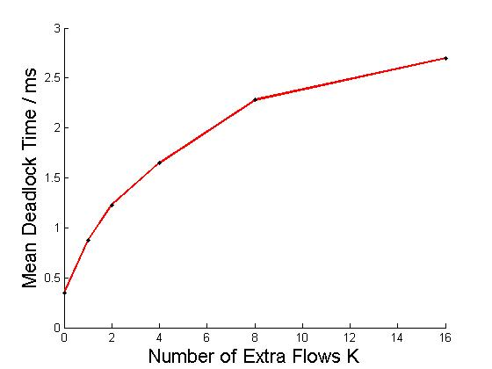
Simulation results – Exp2
Setting:
limit send rate of each extra flow to 10/K Gbps.
Vary K from 0 to 29.
as K goes up, the time to form deadlock will also go up.

Slide 4
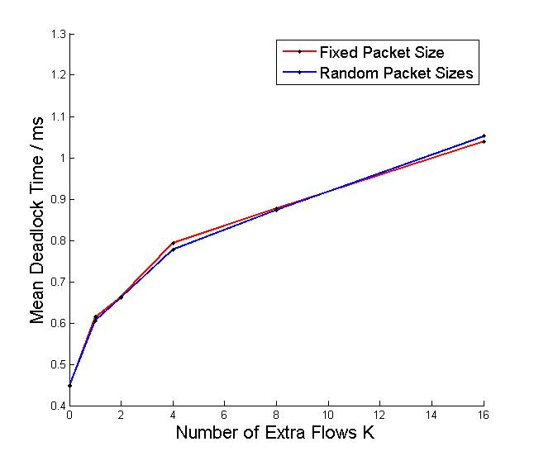
Simulation results – Exp3
Setting:
Repeat Exp1, but make each packet a random size between 100-1000.
Vary K from 0 to 29.
Random packet sizes does not increase the deadlock time.

Slide 5
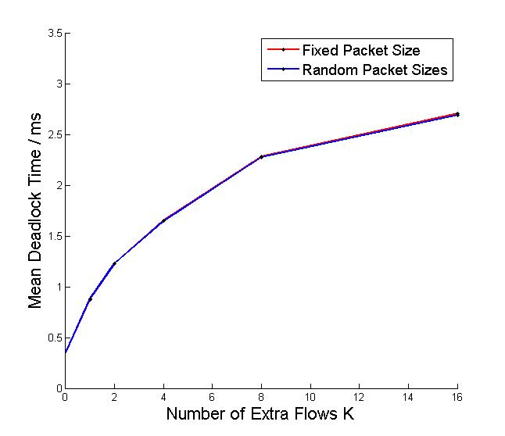
Simulation results – Exp4
Setting:
Repeat Exp2, but make each packet a random size between 100-1000.
Vary K from 0 to 29.
Random packet sizes does not increase the deadlock time.

